Slide 1

Yr 10
Algebra
Simultaneous Equations

Slide 2
Hook Algebra Aerobics
Use your arms to create linear lines and have the students say if its positive, negative, x, -x , 2x and so on.

Slide 3
Lesson objective
By the end of this lesson you will be able to
Identify the point of Interception.
Place coordination's back into equations
Notes:
Lesson

Slide 4
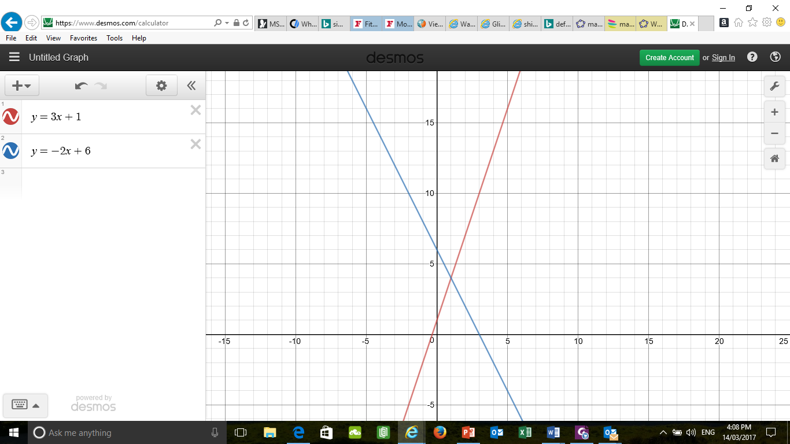
24
7
30
Date
Linear Algebra
EQ – How do I find the point of interception of the two lines?
What are Simultaneous equations? Simultaneous equations are equations involving two or more unknown quantities.
5
Notes:
Lesson objective (EQ)

Slide 5

24
7
30
Date
Linear Algebra
EQ – How do I find the point of interception of the two lines?
Start by plotting the equations on a Cartesian plane. Once both lines have been drawn, look for the point of interception (where the lines cross). The coordinates are the answer to the problem. The first number is ALWAYS x and the second is ALWAYS y. Below the coordinates are (1,4).
5
Notes:
Lesson objective (EQ)

Slide 6
http://education.abc.net.au/home#!/media/1604897/solving-linear-simultaneous-equations-graphically

Slide 7


24
7
30
Date
Linear Algebra
EQ – How do I represent a line in the Gradient Intercept form
Once you have drawn the line and found the point of interception its time to put those coordinates back into your equations. Take the equations underneath for example that had an interception point of (1,4) Place the 1 where the x is and the 4 where the y is.
4=3 $×$ 1 +1 =4
4=-2 $×$ 1 +6 = 4
They are the same. Yay
5
Notes:
Lesson objective (EQ)

Slide 8
24
7
30
Linear Algebra
Date
5
Notes:
Lesson objective (EQ)

